Slide 1
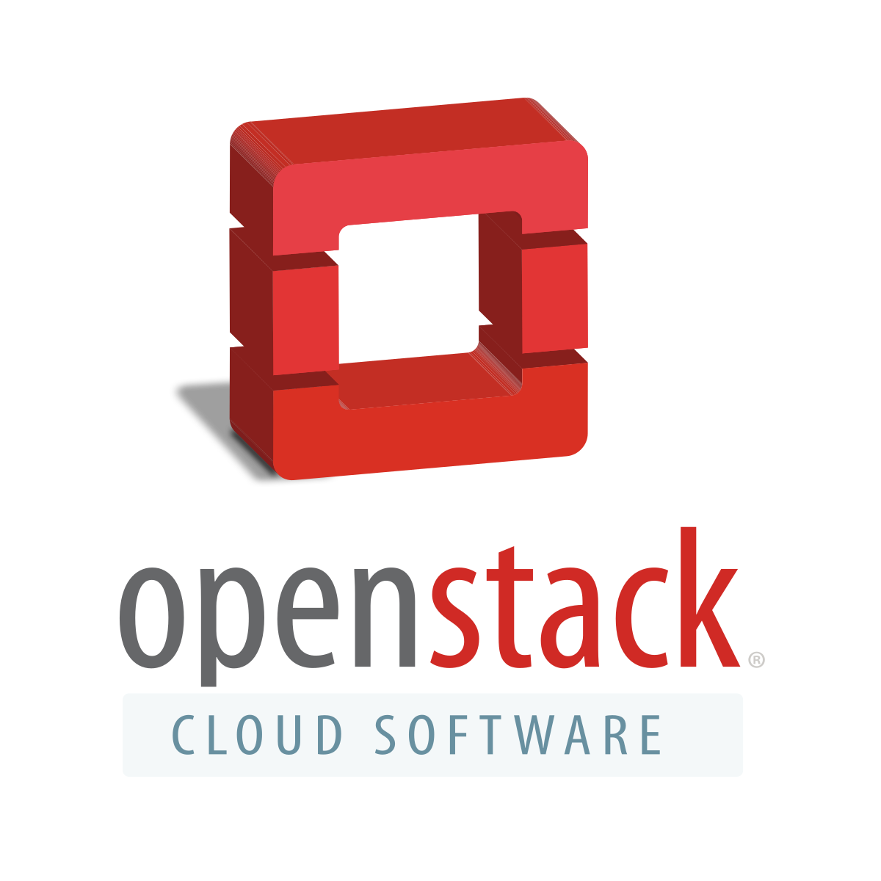
TOPIC : - OPENSTACK

Slide 2
Subtopics
Introduction to Cloud
What is OpenStack
Benefits of OpenStack
OpenStack in Cloud
Deployment Models of OpenStack
OpenStack Architecture
OpenStack Components

Slide 3

Introduction to Cloud
Cloud :-
“The Cloud is just a metaphor for the internet.”
> In the simplest terms, cloud computing means storing and accessing data and programs over the internet instead of your computer’s hard drive.
> It simply means accessing hardware and software services from a provider, on the internet.

Slide 4
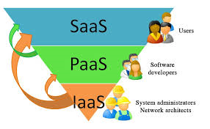
Cloud Service Models
SaaS
Saas Applications are designed for end-users, delivered over the web.
Eg. Office365
PaaS
PaaS is a set of tools and services designed for developers. Developers can develop and host applications on it.
Eg. Google App Engine, Windows Azure
IaaS
IaaS is the infrastructure service which includes servers, storage, networks, and operating systems.
Eg. OpenStack, AWS

Slide 5
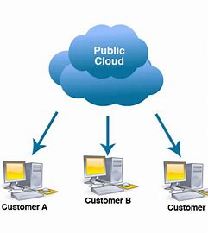
Types of Cloud
Public clouds
- Public clouds are cloud systems that are available for everyone’s use.
- Public cloud services can be both free and subscription based, depending on the user’s needs and provider’s business policy.

Slide 6
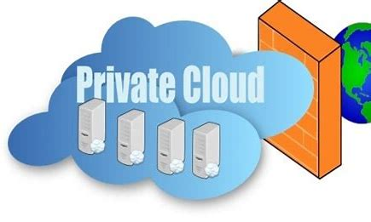
Private clouds
- A private cloud can offer the same services as a public cloud.
- Its services are limited to people behind the company’s firewall.

Slide 7
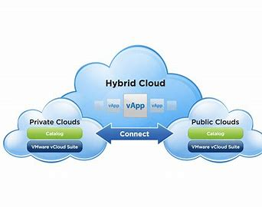
Hybrid clouds
Hybrid cloud is a heterogenous distributed system resulted by combining facilities of public cloud and private cloud.
It takes advantages of both public and private cloud.

Slide 8

What is OpenStack
> OpenStack is a set of software tools that you can use to build your own cloud infrastructure, and you can use that infrastructure to build your applications on it.
> OpenStack is a cloud OS that is used to control the large pools of computing, storage and networking resources within a data center.
> OpenStack provides you with infrastructure when it comes to provide a cloud service.
> It was created in 2010 by Rackspace and NASA companies.
> OpenStack is the future of cloud computing backed by some of the biggest companies.

Slide 9
Benefits of OpenStack
Open Source
Scalability
Security
Easy to access and manage
Services
Strong community

Slide 10
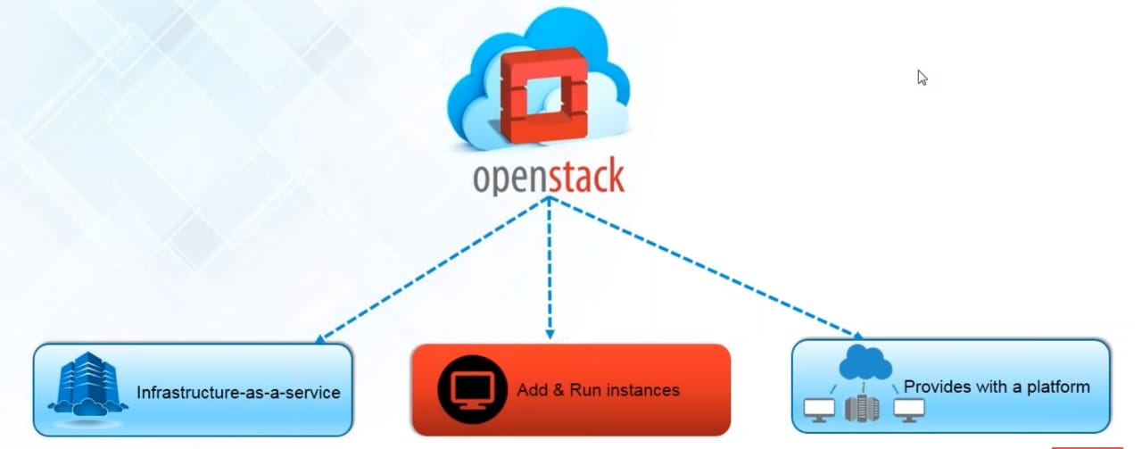
OpenStack in Cloud

Slide 11


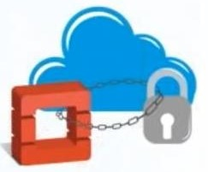
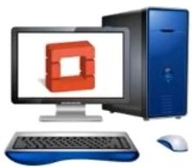
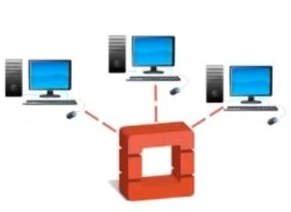
Deployment Models of OpenStack
Deployment Models |  | Description
On - Premises Distribution |  | In this model, a customer downloads and installs an OpenStack distribution within their internal network. Means your Datacenter is in your Company.
OpenStack based Public Cloud |  | A provider provides a public cloud computing system based on the openstack project. Therefore, there is a cloud provider that is responsible for creating the infrastructure and designing all the services needs.
Hosted OpenStack Private Cloud |  | In this, a vendor hosts an OpenStack-based private cloud: including the underlying hardware and the OpenStack software.
OpenStack - as - as - Service |  | Here, a vendor hosts OpenStack management software (without any hardware) as a service. Customers sign up for the service and pair it with their internal servers, storage and networks to get a fully operational private cloud.
Appliance based OpenStack |  | Nebula was a vendor that sold appliances that could be plugged into a network which spawned an OpenStack deployment.

Slide 12
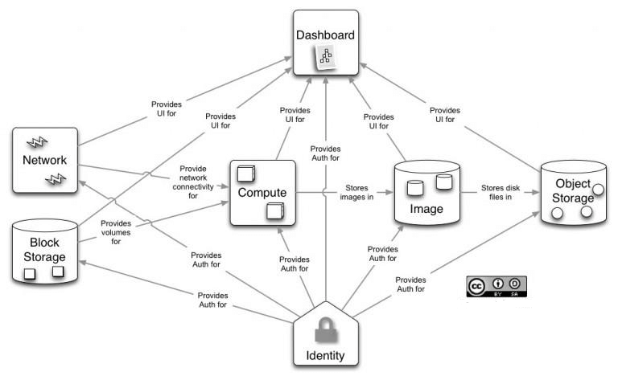
OpenStack Architecture

Slide 13
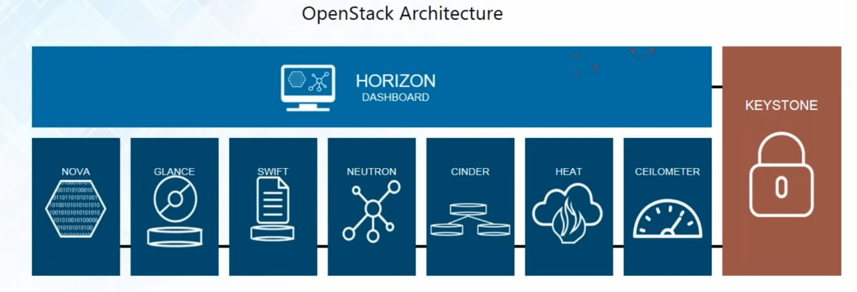

Slide 14
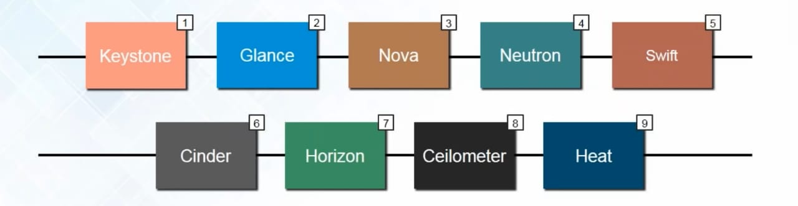
OpenStack Components

Slide 15
OpenStack Components
Keystone (Identity)
It is the central repository of all the users and their permissions for the OpenStack services they use. This component is used to manage identity services like authorization, authentication, AWS Styles (Amazon Web Services) logins, token-based systems, and checking the other credentials (username & password).
_______________________________________________________________
Glance (Image)
This component offers image services to OpenStack. Here, image service means the images or virtual copies of hard disks. When we plan to deploy a new virtual machine instance, glance allows us to use these images as templates.

Slide 16
Nova (Compute)
Nova is one of the most common and important components of OpenStack. Compute is a controller that is used to handle virtualized environments' resources. It handles several virtual machines and other instances that perform computing tasks.
_______________________________________________________________
Neutron (Networking)
This component is used for networking in OpenStack. Neutron manages all the network-related queries, such as IP address management, routers, subnets, firewalls, VPNs, etc. It confirms that all the other components are well connected with the OpenStack.

Slide 17
Swift (Object Storage)
To store and retrieve arbitrary data in the cloud, object storage is used. In Swift, it is possible to store the files, objects, backups, images, videos, virtual machines, and other unstructured data.
______________________________________________________________
Cinder (Block Storage)
This works in the traditional way of attaching and detaching an external hard drive to the OS for its local use. Cinder manages to add, remove, create new disk space in the server. This component provides the virtual storage for the VMs in the system.

Slide 18
Horizon (Dashboard)
This is the first component that the user sees in the OpenStack. Horizon is the web UI (user interface) component used to access the other back-end services.
___________________________________________________________________________
Ceilometer
It allows the collection of data generated by OpenStack services. These data can be used for processes such as customer invoicing and system monitoring.

Slide 19
Heat
Heat provides the OpenStack users with a way to automate the creation of cloud components like networks,instances,storage devices and much more.

Slide 20
Thank You

